Slide 1
Applied Data Science – Week 3
Data Understanding
Dr. Muhammad Fakhrurrifqi
Anindita Suryarasmi, Ph.D.

Slide 2
Outline
Data understanding
Data review
Data sources
Data types

Slide 3
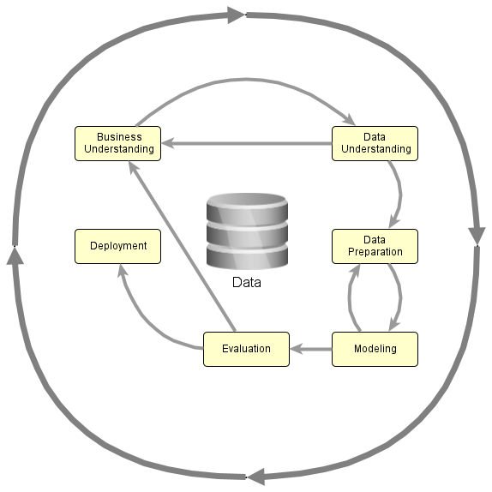
What is data understanding
Done after the business problem is defined in the Business Understanding stage.
Goal: Get a clear overview of the data.
If the data is well understood, move to Data Preparation.
If the business problem needs to be revised, go back to Business Understanding.

Slide 4
Why data understanding is necessary
Data = raw material for an AI solution
Data from different sources may not be directly usable because:
  They have different purposes and objectives.
  They may be separate or tightly integrated.
  They have different levels of richness.
  They have different levels of reliability.
Data Understanding Helps Identify
  Data strengths
  Data limitations and weaknesses
  Data suitability for the business problem
  Data availability (open/closed, access cost, etc.)

Slide 5
Data review process
Identify how data connects to the business process
Identify the main data sources and how to access them
Assess the business value of the data
Identify additional data sources for improvement

Slide 6
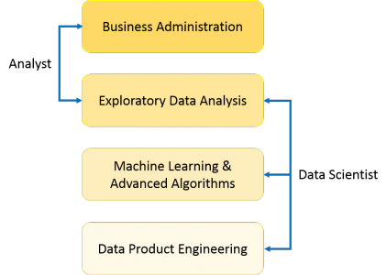
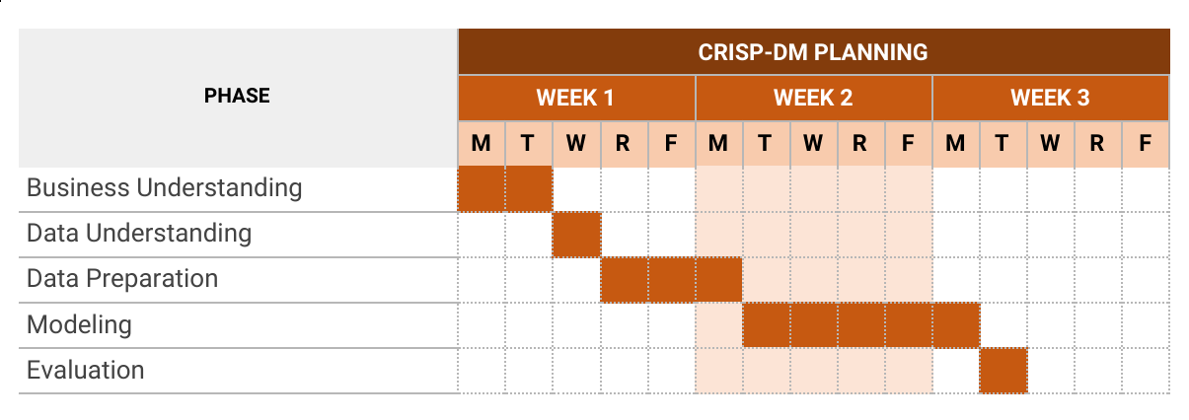
Data understanding
Data Collection Report
Data Description Report
Data Exploration Report
Data Quality Report

Slide 7
Data understanding documentation
Data Collection Report
Data Sources
  Existing data
  Purchased Data
  Additional Data
Attribute of data
Enough data?
Merging various data
Data Description Report
Describing Data
  Amount of Data
  Value Types
  Coding Scheme
Data Quantity (Format, method to capture, how large)
Data Quality (characteristic, type of data)
Compute basic statis of key attributes
Priority of attributes

Slide 8
Data understanding documentation
Data Exploration Report
Hypothesis of data
Promising attributes for further analysis
Exploration of new characteristics of data
How change initial hypothesis
Identify subset of data for later use
Compare with goals
Data Quality Report
Missing Data
Data Errors
Measurement Errors
Missing attributes and blank fields
Spelling inconsistencies?
Noise
Plausibility check for values (conflict of values)
Considering to exclude data that has no impact to hypothesis
Are data stored in flat files? Are delimeter consistent, How is each record

Slide 9
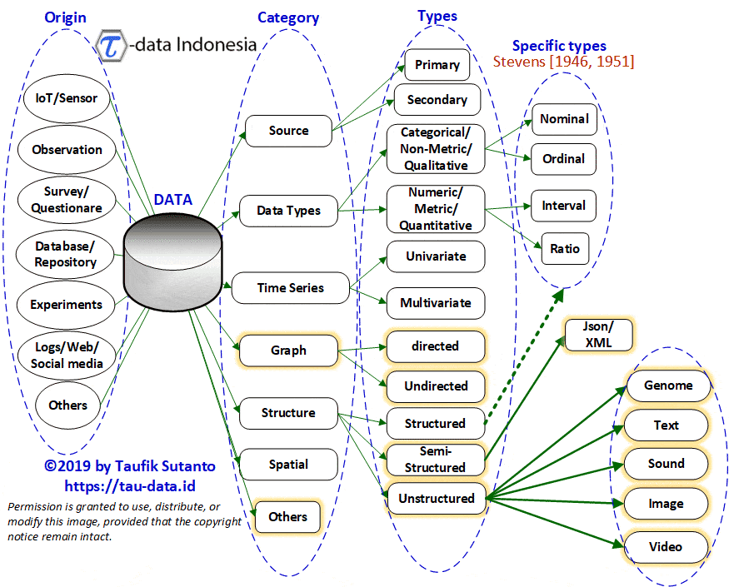
Data Type Map

Slide 10
Data source
Internal sources
  Spreadsheets (Excel, CSV, JSON, etc.)
  Databases: can be queried via SQL, etc.
  Text documents
  Multimedia documents (audio, video)
External sources
  Open data repositories
  Public domain web pages

Slide 11
Online data source
Portal Satu Data Indonesia (https://data.go.id)
Portal Data Jakarta (https://data.jakarta.go.id)
Portal Data Bandung (http://data.bandung.go.id)
Badan Pusat Statistik (https://www.bps.go.id)
Badan Informasi Geospasial (https://tanahair.indonesia.go.id/)
UCI Machine Learning repository (https://archive.ics.uci.edu/ml/index.php)
Kaggle (https://www.kaggle.com/datasets)
World Bank Open Data (https://data.worldbank.org)
UNICEF Data (https://data.unicef.org)
WHO Open Data (https://www.who.int/data)
IBM Data Asset eXchange (https://developer.ibm.com/exchanges/data/)
DBPedia (https://www.dbpedia.org/resources/)
Wikidata (https://www.wikidata.org/)

Slide 12
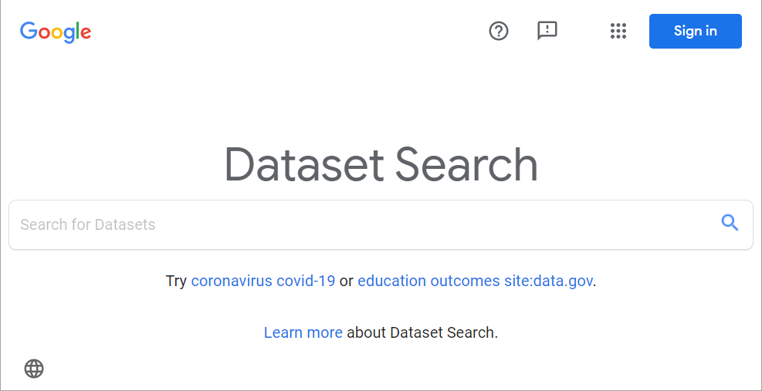
Online data source
Search for datasets using Google Dataset Search.
https://datasetsearch.research.google.com

Slide 13
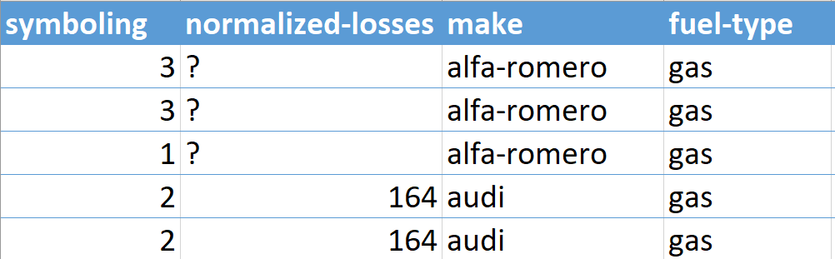
Data Structure
Datum (Data Item)
  The smallest unit of data.
  One value for one specific variable.
Data
  A collection of data items that describes one specific object or entity.
Dataset
  A collection of data.
Metadata
  Data that describes other data.
"make":
Type: string,
Description: Vehicle manufacturer/brand name

Slide 14
Data Types Based on Structure
 | Structured data | Unstructured data
Characteristics | Has a predefined data model. Data items are usually in text format. Data items are clearly separated. Easy to extract and query. | Does not have a predefined data model. Can include text, images, audio, video, and other formats. Data items may be difficult to separate because of irregularity and ambiguity. More difficult to extract and query.
Examples | Tabular data Object-oriented data Time-series data | Free-text documents Audio Video

Slide 15
Semi-structured data
Does not follow a fixed tabular structure like a relational database.
Still contains tags or markers that separate meaningful data elements.
Can represent relationships and hierarchies between data items.

Slide 16
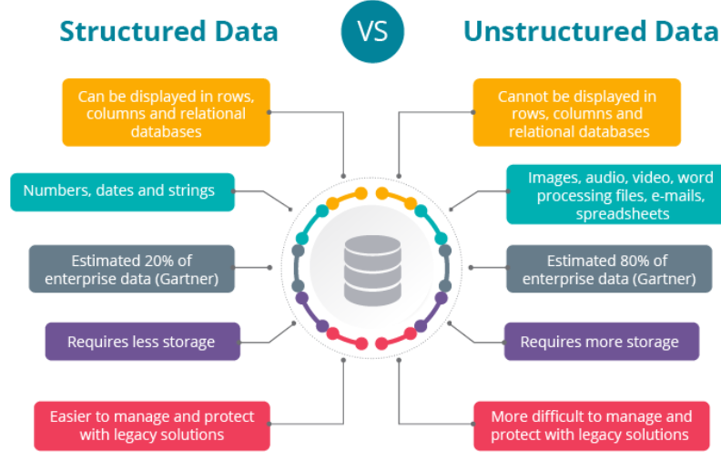
Structured vs unstructured

Slide 17
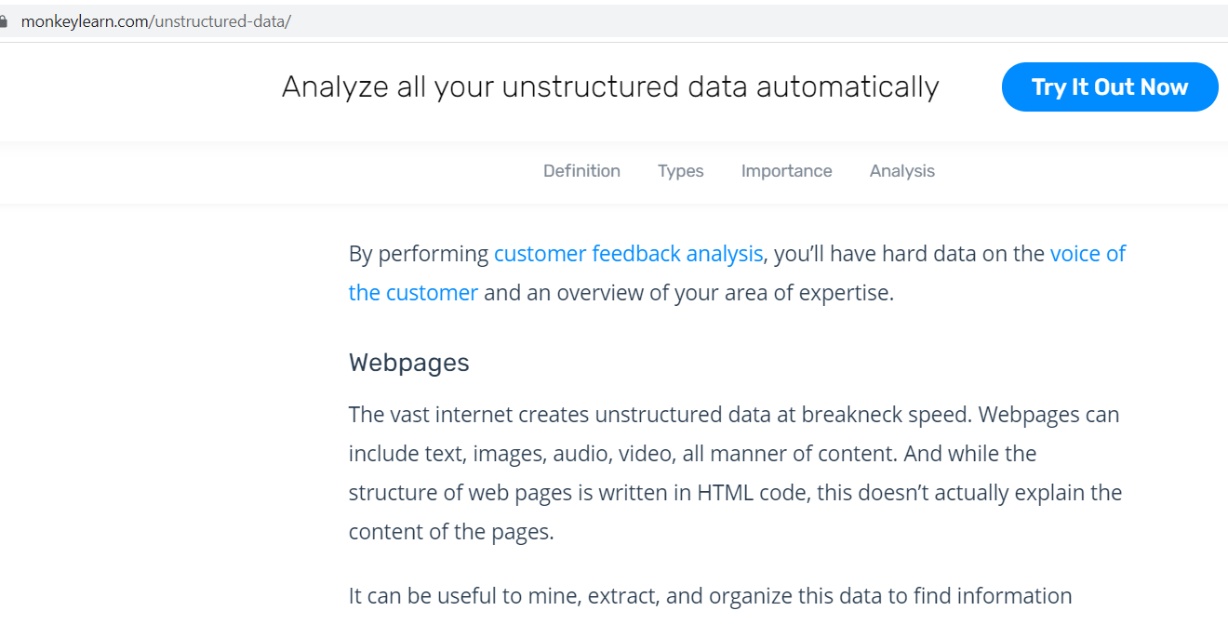
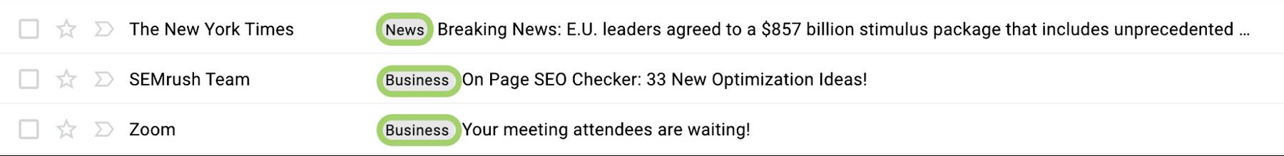

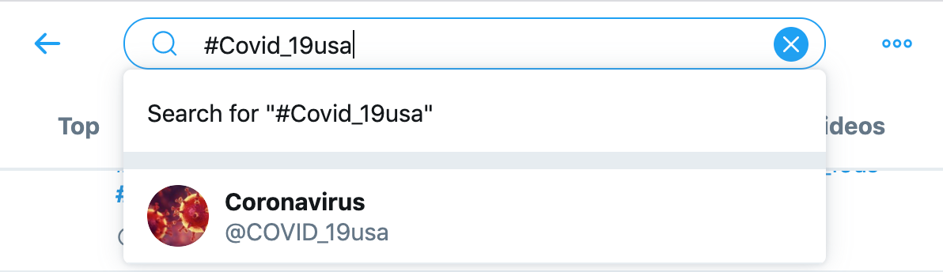
Unstructured data examples
Email
email: semi-structured data; content: unstructured data
Web pages
Customer review
Social media

Slide 18
Data Types Based on Their Properties
Dichotomous data
  Data with only two distinct categories.
  Examples: Yes/No, Male/Female, Pass/Fail.
Discrete data
  Data collected by counting.
  Examples: Number of children, population size, number of deaths.
Continuous data
  Data collected by measurement using a specific scale.
  Examples: Temperature, weight, height, intelligence score.

Slide 19
Data Types Based on Collection Method
Primary data
  Data collected directly by the researcher from the original source.
  Examples: Interviews, surveys, questionnaires.
Secondary data
  Data collected by other people or organizations and then used by the researcher.
  Examples: Government statistics, published reports, existing databases.

Slide 20
Data Item Types
Type | Nature | Example | What the Data Represents | Mathematical Operations
Nominal / Categorical | Discrete, unordered | Color: red, green, blue | Membership | =, ≠
Ordinal | Discrete, ordered | Grades: A, B, C, D, E | Membership, comparison | =, ≠, <, >
Interval | Continuous/numeric, ordered; differences are meaningful | Temperature (°C), calendar dates | Membership, comparison, difference | =, ≠, <, >, +, −
Ratio | Continuous/numeric, ordered; values represent ratios | Road length, temperature (Kelvin) | Membership, comparison, difference, magnitude | =, ≠, <, >, +, −, ×, ÷

Slide 21
Data Item Types (cont.)
Type | Typical Value Representation | Distribution Representation | True Zero
Nominal / Categorical | Modus | Grouping | No
Ordinal | Modus, median | Grouping, Range, Interquartile Range | No
Interval | Modus, median, arithmetic mean | Grouping, Range, Interquartile Range, Variance, Standard Deviation | No
Ratio | Modus, median, arithmetic mean, geometric mean, harmonic mean | Grouping, Range, Interquartile Range, Variance, Standard Deviation, Coefficient of Variation | Yes

Slide 22
Data Types Based on Time
Cross-Sectional Data
  Data collected at one specific point in time.
  Shows the condition of something at a particular time.
  Examples: Financial report as of December 31, 2020; customer data in May 2004.
Time-Series Data
  Data collected over multiple time periods.
  Shows how something changes over time.
  Example: USD/IDR exchange rates from 2016–2020.

Slide 23
Data Model Example: Tabular Data
Consists of N records.
Each record contains D attributes.
Record = row, data point, instance, example, transaction, tuple, entity, object, or feature vector.
Attribute = column, field, dimension, or feature.
The same attribute usually has the same data type for every record.
The structure can be:
  Strict: Relational databases
  Loose: Excel spreadsheets
Formal query languages can be used depending on the structure.
Example: SQL

Slide 24
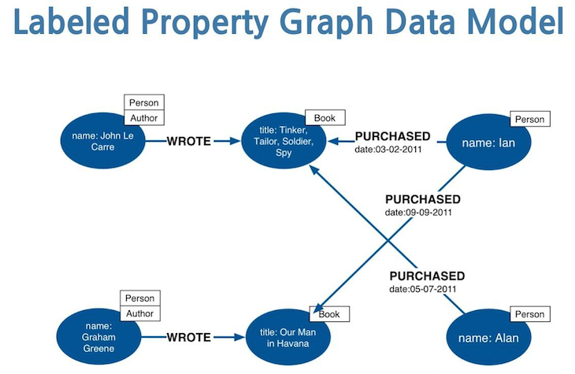
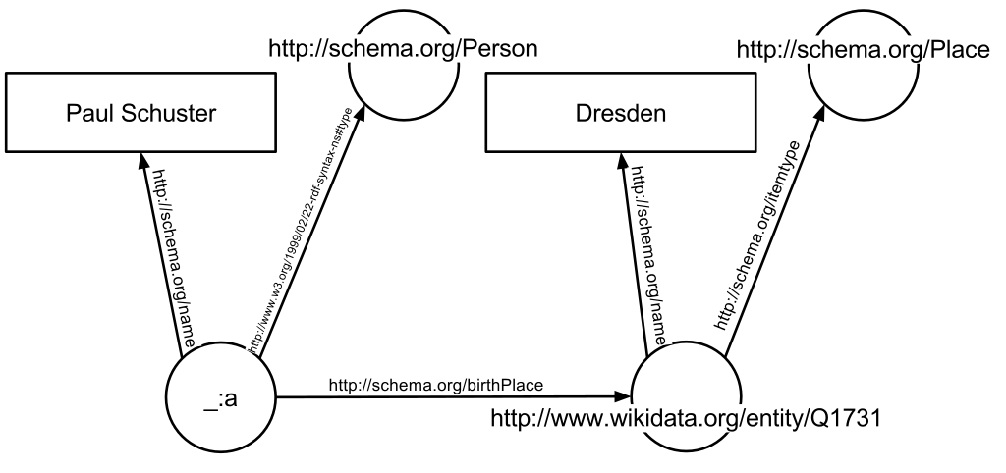
Data Model Example: Graph / Network
Consists of nodes and edges/connections.
One node usually represents one record.
Can explicitly represent relationships between records.
Includes:
  Hierarchical/tree data models
  Object-oriented data models
Modern graph data models include:
  Property Graph
  Resource Description Framework (RDF)
Property graph
RDF graph

Slide 25
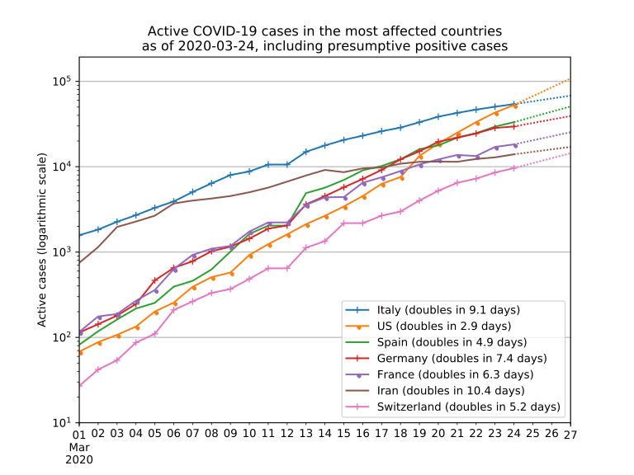
Data Model Example: Sequence
Consists of records connected in a sequence.
Example: Temperature sensor readings over a period of time.
The structure is defined by the order of the records.
Audio and video can be viewed as sequence data, although each record may be unstructured.
Contextual attributes define the implicit dependency. Example: Timestamp
Behavioral attributes are values recorded within a specific context. Example: Temperature
If the contextual attribute is time/timestamp, the sequence data is called time-series data.

Slide 26
Thank you
Any questions?

